Slide 1
Dec. 15th, Presentation for Final Project
Graph Vertex Colorability
& the Hardness
Mengfei Cao
COMP-150 Graph Theory
Tufts University
Notes:
Hello world

Slide 2
Framework
In General:
Graph-2-colorability is in N
Graph-3-colorability is NP-complete (Reduce to k≥4) [2]
Graph-3-colorability with ∆≤4 is NP-complete [1]
Introduce Planarity:
Planar graph is 5-colorable (1890), 4-colorable (1977) [3]
Planar and ∆-free graph is 3-colorable (1959) [4]
Graph-3-colorability on planar graph is NP-complete [1]
Graph-3-colorability on planar graph with ∆≤4 is NP-complete [5]
Introduce ∆-free:
Graph-3-colorability on ∆-free graph with ∆≤4 is NP-complete [5]
Graph-k-colorability on ∆-free graph with ∆ bounded by a function of k, is NP-complete [5]

Slide 3
Framework
In General:
Graph-2-colorability is in N
Graph-3-colorability is NP-complete (Reduce to k≥4) [2]
Graph-3-colorability with ∆≤4 is NP-complete [1]
Introduce Planarity:
Planar graph is 5-colorable (1890), 4-colorable (1977) [3]
Planar and ∆-free graph is 3-colorable (1959) [4]
Graph-3-colorability on planar graph is NP-complete [1]
Graph-3-colorability on planar graph with ∆≤4 is NP-complete [5]
Introduce ∆-free:
Graph-3-colorability on ∆-free graph with ∆≤4 is NP-complete [5]
Graph-k-colorability on ∆-free graph with ∆ bounded by a function of k, is NP-complete [5]
DFS, BFS

Slide 4
Framework
In General:
Graph-2-colorability is in N
Graph-3-colorability is NP-complete (Reduce to k≥4) [2]
Graph-3-colorability with ∆≤4 is NP-complete [1]
Introduce Planarity:
Planar graph is 5-colorable (1890), 4-colorable (1977) [3]
Planar and ∆-free graph is 3-colorable (1959) [4]
Graph-3-colorability on planar graph is NP-complete [1]
Graph-3-colorability on planar graph with ∆≤4 is NP-complete [5]
Introduce ∆-free:
Graph-3-colorability on ∆-free graph with ∆≤4 is NP-complete [5]
Graph-k-colorability on ∆-free graph with ∆ bounded by a function of k, is NP-complete [5]

Slide 5
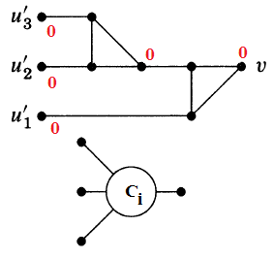
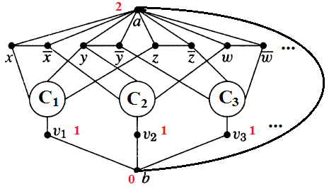
Graph-3-colorability
In NP: verify a coloring in O(|E|+|V|), BFS or DFS
Reduction from 3-SAT:
An instance of 3-SAT with literals U={u_{j}} and clauses C={Ci};
Consider the following transformation to graph G so that there exists a satisfying truth assignment for all {C_{i}} i.f.f. there is a proper 3-coloring {0, 1, 2}:
3-colorable;
Output = 0, when all inputs are 0;
0, 1 or 2, o.w.
Assign -> coloring;
Coloring -> assign

Slide 6
Framework
In General:
Graph-2-colorability is in N
Graph-3-colorability is NP-complete (Reduce to k≥4) [2]
Graph-3-colorability with ∆≤4 is NP-complete [1]
Introduce Planarity:
Planar graph is 5-colorable (1890), 4-colorable (1977) [3]
Planar and ∆-free graph is 3-colorable (1959) [4]
Graph-3-colorability on planar graph is NP-complete [1]
Graph-3-colorability on planar graph with ∆≤4 is NP-complete [5]
Introduce ∆-free:
Graph-3-colorability on ∆-free graph with ∆≤4 is NP-complete [5]
Graph-k-colorability on ∆-free graph with ∆ bounded by a function of k, is NP-complete [5]

Slide 7
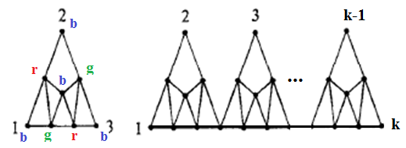
Graph-3-colorability ∆≤4 (G₃*)
In NP: verify a coloring in O(|E|+|V|), BFS or DFS
Reduction from graph-3-colorability(G₃):
An instance of graph G₃;
Consider the following transformation to graph G₃* so that there exists a proper 3-coloring for G₃ i.f.f. there is a proper 3-coloring for G₃*:
For any u in G₃ with degree k > 4, substitute it with H_{k}
H_{k} <- H_{k-1} + H₃
H₃
H_{k}
0) 3-colorable
All the k outlet vertices must share the same colors
Coloring to G₃ <=> Coloring to G₃*

Slide 8
Framework
In General:
Graph-2-colorability is in N
Graph-3-colorability is NP-complete (Reduce to k≥4) [2]
Graph-3-colorability with ∆≤4 is NP-complete [1]
Introduce Planarity:
Planar graph is 5-colorable (1890), 4-colorable (1977) [3]
Planar and ∆-free graph is 3-colorable (1959) [4]
Graph-3-colorability on planar graph is NP-complete [1]
Graph-3-colorability on planar graph with ∆≤4 is NP-complete [5]
Introduce ∆-free:
Graph-3-colorability on ∆-free graph with ∆≤4 is NP-complete [5]
Graph-k-colorability on ∆-free graph with ∆ bounded by a function of k, is NP-complete [5]

Slide 9
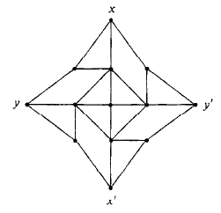
Introduce Planarity
Planar graph is 5-colorable (Heawood, 1890)
Consider 5 components
Planar graph is 4-colorable (Appel-Haken-Koch, 1977)
Unavoidable configurations
Planar and ∆-free graph is 3-colorable (Grotzsch, 1959)
Grotzsch’s Theorem
Graph-3-colorability on planar graph is NP-complete [1]
Graph-3-colorability on planar graph with ∆≤4 is NP-complete [5]
From graph-3-colorability

Slide 10
Framework
In General:
Graph-2-colorability is in N
Graph-3-colorability is NP-complete (Reduce to k≥4) [2]
Graph-3-colorability with ∆≤4 is NP-complete [1]
Introduce Planarity:
Planar graph is 5-colorable (1890), 4-colorable (1977) [3]
Planar and ∆-free graph is 3-colorable (1959) [4]
Graph-3-colorability on planar graph is NP-complete [1]
Graph-3-colorability on planar graph with ∆≤4 is NP-complete [5]
Introduce ∆-free:
Graph-3-colorability on ∆-free graph with ∆≤4 is NP-complete [5]
Graph-k-colorability on ∆-free graph with ∆ bounded by a function of k, is NP-complete [5]

Slide 11
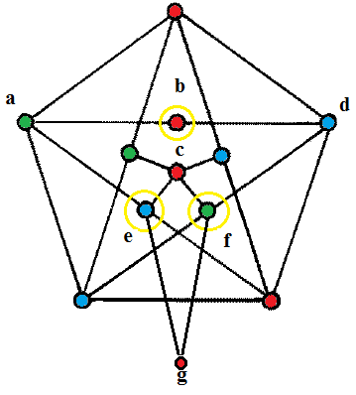
Graph-3-colorability, ∆-free & ∆≤4 (G3*)
In NP: verify a coloring in O(|E|+|V|), BFS or DFS
Reduction from G3 with ∆≤4 (G3):
An instance of graph G3 without 4-clique;
Consider the following auxiliary graph used to transform from G3 to graph G3* so that there exists a 3-coloring on G3 i.f.f. there is a proper 3-coloring on G3*:
Auxiliary graph H:
1) ∆-free & 3-colorable;
2) b, e, f are colored 3 different colors;
3) b and c share the same color 1;
4) a and d are colored 2 and 3; therefore e and f are colored 3 and 2.
5) So b and g have same color 1 and degree 2; -- outlets

Slide 12
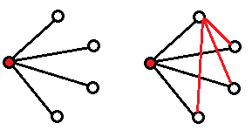
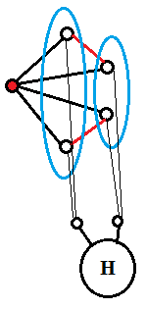
Start with G₀ = G:
Repeat for i=1,…,n:
Consider each vertex u_{j}, j=1,2,…,n;
If every neighborhood N(u_{j}) in G_{i} has no edge or isomorphic to K_{1,3}, then G_{i}=G_{i-1};
Else partition N(u_{j}) into two
independent sets with size ≤2
and substitute u_{j} with H(u_{j}),
connecting the outlets to each sets;
G* = G_{n}
G* has no triangles and ∆≤4;
A proper 3-coloring to G is also a
3-coloring to G*
A proper 3-coloring to G* is also a 3-coloring to G.
#

Slide 13
Framework
In General:
Graph-2-colorability is in N
Graph-3-colorability is NP-complete (Reduce to k≥4) [2]
Graph-3-colorability with ∆≤4 is NP-complete [1]
Introduce Planarity:
Planar graph is 5-colorable (1890), 4-colorable (1977) [3]
Planar and ∆-free graph is 3-colorable (1959) [4]
Graph-3-colorability on planar graph is NP-complete [1]
Graph-3-colorability on planar graph with ∆≤4 is NP-complete [1]
Introduce ∆-free:
Graph-3-colorability on ∆-free graph with ∆≤4 is NP-complete [5]
Graph-k-colorability on ∆-free graph with ∆ bounded by a function of k, is NP-complete [5]

Slide 14
Graph-k-colorability (∆?)
Graph-k-colorability on ∆-free graph with ∆ bounded by a function of k, is NP-complete [5]
A randomized polynomial time algorithm (Karger, Motwani Sudan, 1998 [8] ) gives
min{O(∆^{1/3}log^{1/2} ∆logn), O(n^{1/4}log^{1/2}n)}
approximation on 3-colorable graph; and
min{O(∆ 1-2/klog1/2 ∆logn), O(n1-3/(k+1)log1/2n)}
approximation on k-colorable graph.
Approximation Bound
Non-constant guarantee [10], [11]:
For any e>0, it is hard to obtain Ω(n^{-e}) factor approximation unless NP in ZPP(zero-error probabilistic polynomial time).
Other approximation:
3-color: O(n^{1/2}) [7], ~O(n^{0.25}) [8], O(n^{0.2072}) [9]

Slide 15
References
[1] M.R. Garey and D.S. Johnson, Computer and Intractability: A Guide to the Theory of Npcompleteness , W.H. Freeman, San Fransisco, 1979.
[2] R.M. Karp, Reducibility among combinatorial problems, Plenum Press, New York, 1972.
[3] D. West, Introduction to Graph Theory, 2nd edition, Prentice-Hall, 2001
[4] B. Grfinbaum, Grotzsch's theorem on 3-colorings, Michigan Math. J. 10, 1963.
[5] F. Maffray and M. Preissmann, On the NP-completeness of the k-colorability problem for triangle-free graphs. Discrete Math. 162, 1996
[6] A. Wigderson. Improving the performance guarantee for approximate graph coloring. J. ACM, 30(4):729–735, 1983.

Slide 16
[8] D. R. Karger, R. Motwani, and M. Sudan. Approximate graph coloring by semidefinite programming. In IEEE Symposium on Foundations of Computer Science, 1994.
[9] E. Chlamtac. Approximation algorithms using hierarchies of semidefinite programming relaxations. FOCS: Proceedings of the 48th Annual IEEE Symposium on Foundations of Computer Science, 2007
[10] U. Feige and J. Kilian. Zero Knowledge and chromatic number. In Proceedings of the 11th Annual Conference on Structure in Complexity Theory, 1996
[11] U. Feige, S. Goldwasser, L. Lovasz, et.al. Interactive proofs and the hardness of approximating cliques. Em Journal of the ACM, 1996

Slide 17
Thanks!
Questions and Comments?

