Slide 1
An Introduction to
Algorithmic Tile Self-Assembly

Slide 2
Self-Assembly
Simple particles coalescing into
complex superstructures.

Slide 3
Self-Assembly
Simple particles coalescing into
complex superstructures.

Slide 4
Self-Assembly
Simple particles coalescing into
complex superstructures.

Slide 5
Self-Assembly
Simple particles coalescing into
complex superstructures.

Slide 6
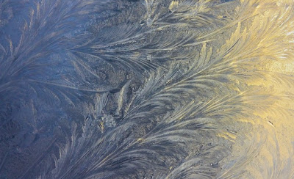
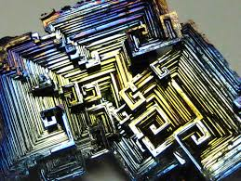
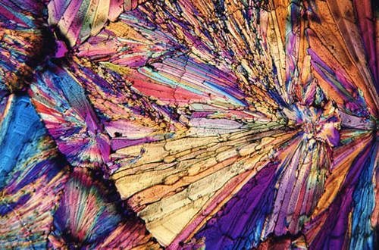
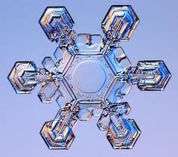
Crystallization
Notes:
Very simple particles, ubiqutous

Slide 7
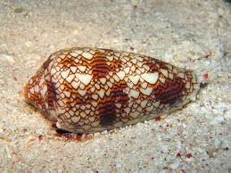
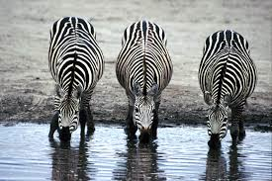
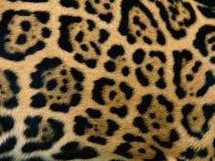
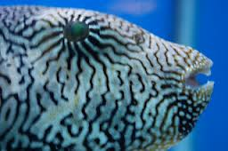
Morphogenesis
Notes:
Can produce highly intricate structures that are randomly sampled from a special, complex distribution

Slide 8
Natural Self-Assembly

Slide 9
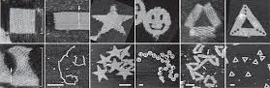
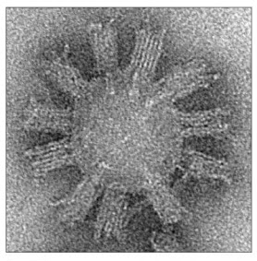
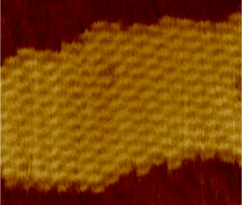
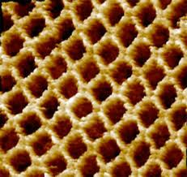
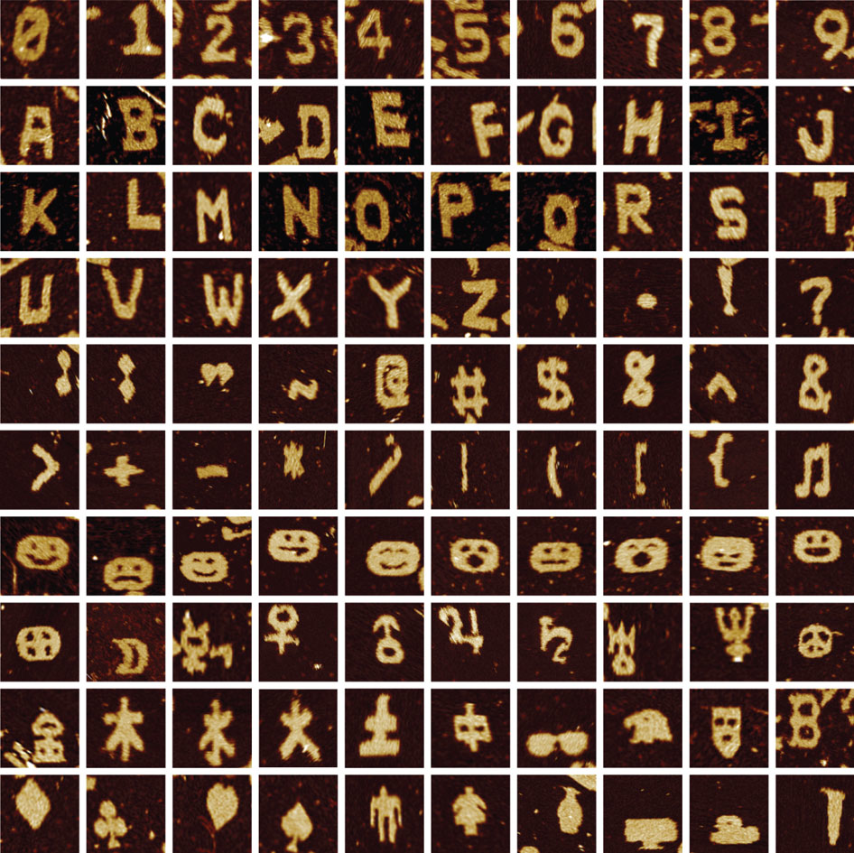
Synthetic Self-Assembly with DNA
Notes:
Variety of proof-of-concept shapes possible. Nanoscale (applications to build things smaller than otherwise possible). DNA is information-rich (more varied behavior in self-assembly).

Slide 11
Tile

Slide 12
Glues

Slide 15
Tile

Slide 16
Glues

Slide 17
Strength-2
Strength-1

Slide 19
×∞
×∞
×∞
×∞
×∞
Temperature

Slide 21
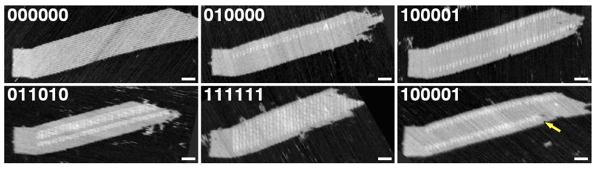
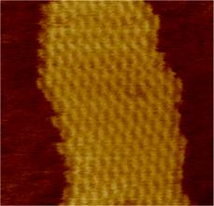
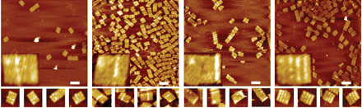
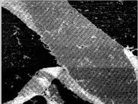
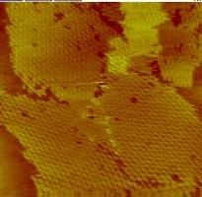
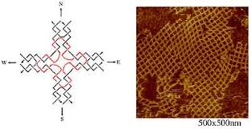
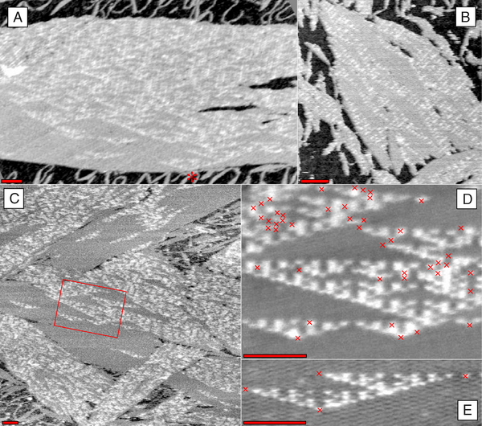
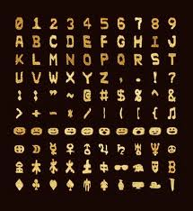
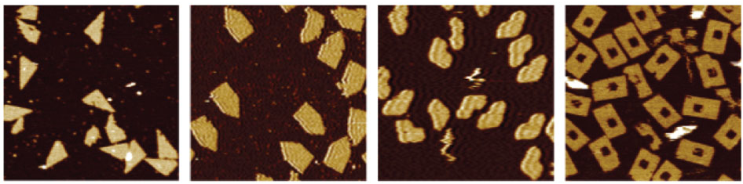
Self-assembling tiles: a real thing

Slide 22
Assembling patterned shapes
P. W. K. Rothemund, N. Papadakis, E. Winfree, Algorithmic self-assembly of DNA Sierpinski triangles. PLoS Biology (12), 2004.

Slide 26
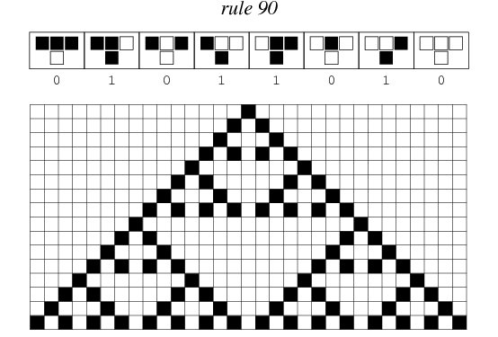
Cellular automata

Slide 27
Tile assembly can simulate CA

Slide 31
Binary counter

Slide 32
Self-assembling tile systems (finite & infinite)

Slide 39
Initiatilization
Copy tiles
Increment tiles
Halt tile

Slide 43
Building squares
Build a column and row, then fill L-shape with tiles.

Slide 44
Building rectangles
Encode start and end values:
  Start: north glues (0..2^{t})
  End: # tiles (2^{t})
Building a rectangle of height h (h in 2^{t}..2^{t+1})
requires O(t) = O(log(h)) tiles.

Slide 45
Building rectangles
Encode start and end values:
  Start: north glues (0..2^{t})
  End: # tiles (2^{t})
Possible to do better?

Slide 46
Each tile set encodes the height of the rectangle built.
The tile set needs sufficient information to do so.
Most heights have ≥ 0.5*log₂(h) bits of information.
How many bits of information does a tile set with t tile types have?
Let g be number of glue types on the tiles. Then g/4 ≤ t ≤ g⁴.
So specifying a tile takes ≤ 4*log₂(g) ≤ 4*log₂(4t) ≤ 12*log₂(t) bits.
So the entire set has at most t(12*log₂(t)) ≤ 12t*log₂(t) bits.
So most heights need 0.5*log₂(h) ≤ 12t*log₂(t).
By algebra, t = Ω(log(h)/loglog(h)).

Slide 47
Building rectangles and squares
Possible to build any height rectangle and any size square (at τ= 2) using O(log(h)) tile types.
More than half of all heights require a tile set of size Ω(log(h)/loglog(h)).
Possible to build any height rectangle (at τ= 2) using O(log(h)/loglog(h)) tile types.
[Winfree, Soloveichik 2000]
[Winfree, Soloveichik 2000]
[Adleman et al. 2001]

Slide 48
Building rectangles and squares (at τ= 1)
n
h
n
2n-1 tile types
h tile types
Possible to do better? (Open problem)

Slide 49
Computing with self-assembly (via CA)
[http://mathworld.wolfram.com/Rule90.html]
Some CA can simulate Turing machines: CA ≥ TM
Can simulate these CA with tiles: SA ≥ CA
So tiles can simulate Turing machines: SA ≥ TM
[Lindgren, Nordahl 1990]
[Winfree 1998]

Slide 50
Computing with self-assembly (direct)
Input
Machine
Computation
Input

Slide 51
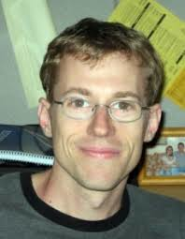
A Turing machine example…
[courtesy of Scott Summers]

Slide 52
Let M = (Q,Σ,Γ,δ,q₀,q_{halt}), where Q = {q₀,q₁,q₂,q_{halt}}, Σ = {1}, Γ = {1,└┘}, and δ is defined in the following table…
δ | 1 | └┘
q₀ | q₂,1,L | q₁,1,R
q₁ | q₁,1,R | q₀,1,L
q₂ | q_{halt} | q₁,1,L
C₀
└┘
└┘
└┘
└┘
└┘
└┘
q₀1
└┘
└┘
└┘
└┘
└┘
└┘
q₀
└┘
└┘
└┘
└┘
└┘
└┘
└┘
└┘
└┘
└┘
1
└┘
└┘
└┘
└┘
└┘
└┘
└┘
└┘
└┘
└┘

Slide 53
Let M = (Q,Σ,Γ,δ,q₀,q_{halt}), where Q = {q₀,q₁,q₂,q_{halt}}, Σ = {1}, Γ = {1,└┘}, and δ is defined in the following table…
δ | 1 | └┘
q₀ | q₂,1,L | q₁,1,R
q₁ | q₁,1,R | q₀,1,L
q₂ | q_{halt} | q₁,1,L
C₀
└┘
└┘
└┘
└┘
└┘
└┘
q₀1
└┘
└┘
└┘
└┘
└┘
└┘
q₀
└┘
└┘
└┘
└┘
└┘
└┘
└┘
└┘
└┘
└┘
1
└┘
└┘
└┘
└┘
└┘
└┘
└┘
└┘
└┘
└┘

Slide 54
Let M = (Q,Σ,Γ,δ,q₀,q_{halt}), where Q = {q₀,q₁,q₂,q_{halt}}, Σ = {1}, Γ = {1,└┘}, and δ is defined in the following table…
δ | 1 | └┘
q₀ | q₂,1,L | q₁,1,R
q₁ | q₁,1,R | q₀,1,L
q₂ | q_{halt} | q₁,1,L
C₁
└┘
└┘
└┘
└┘
└┘
q_{2└┘}
1
└┘
└┘
└┘
└┘
└┘
└┘
C₀
└┘
└┘
└┘
└┘
└┘
└┘
q₀1
└┘
└┘
└┘
└┘
└┘
└┘
q₂
└┘
└┘
└┘
└┘
└┘
└┘
└┘
└┘
└┘
└┘
1
└┘
└┘
└┘
└┘
└┘
└┘
└┘
└┘
└┘
└┘

Slide 55
Let M = (Q,Σ,Γ,δ,q₀,q_{halt}), where Q = {q₀,q₁,q₂,q_{halt}}, Σ = {1}, Γ = {1,└┘}, and δ is defined in the following table…
δ | 1 | └┘
q₀ | q₂,1,L | q₁,1,R
q₁ | q₁,1,R | q₀,1,L
q₂ | q_{halt} | q₁,1,L
C₁
└┘
└┘
└┘
└┘
└┘
q_{2└┘}
1
└┘
└┘
└┘
└┘
└┘
└┘
C₀
└┘
└┘
└┘
└┘
└┘
└┘
q₀1
└┘
└┘
└┘
└┘
└┘
└┘
q₂
└┘
└┘
└┘
└┘
└┘
└┘
└┘
└┘
└┘
└┘
1
└┘
└┘
└┘
└┘
└┘
└┘
└┘
└┘
└┘
└┘

Slide 56
Let M = (Q,Σ,Γ,δ,q₀,q_{halt}), where Q = {q₀,q₁,q₂,q_{halt}}, Σ = {1}, Γ = {1,└┘}, and δ is defined in the following table…
δ | 1 | └┘
q₀ | q₂,1,L | q₁,1,R
q₁ | q₁,1,R | q₀,1,L
q₂ | q_{halt} | q₁,1,L
C₂
└┘
└┘
└┘
└┘
q_{1└┘}
1
1
└┘
└┘
└┘
└┘
└┘
└┘
C₁
└┘
└┘
└┘
└┘
└┘
q_{2└┘}
1
└┘
└┘
└┘
└┘
└┘
└┘
C₀
└┘
└┘
└┘
└┘
└┘
└┘
q₀1
└┘
└┘
└┘
└┘
└┘
└┘
q₁
└┘
└┘
└┘
└┘
└┘
└┘
└┘
└┘
└┘
1
1
└┘
└┘
└┘
└┘
└┘
└┘
└┘
└┘
└┘
└┘

Slide 57
Let M = (Q,Σ,Γ,δ,q₀,q_{halt}), where Q = {q₀,q₁,q₂,q_{halt}}, Σ = {1}, Γ = {1,└┘}, and δ is defined in the following table…
δ | 1 | └┘
q₀ | q₂,1,L | q₁,1,R
q₁ | q₁,1,R | q₀,1,L
q₂ | q_{halt} | q₁,1,L
C₂
└┘
└┘
└┘
└┘
q_{1└┘}
1
1
└┘
└┘
└┘
└┘
└┘
└┘
C₁
└┘
└┘
└┘
└┘
└┘
q_{2└┘}
1
└┘
└┘
└┘
└┘
└┘
└┘
C₀
└┘
└┘
└┘
└┘
└┘
└┘
q₀1
└┘
└┘
└┘
└┘
└┘
└┘
q₁
└┘
└┘
└┘
└┘
└┘
└┘
└┘
└┘
└┘
1
1
└┘
└┘
└┘
└┘
└┘
└┘
└┘
└┘
└┘
└┘

Slide 58
Let M = (Q,Σ,Γ,δ,q₀,q_{halt}), where Q = {q₀,q₁,q₂,q_{halt}}, Σ = {1}, Γ = {1,└┘}, and δ is defined in the following table…
δ | 1 | └┘
q₀ | q₂,1,L | q₁,1,R
q₁ | q₁,1,R | q₀,1,L
q₂ | q_{halt} | q₁,1,L
C₃
└┘
└┘
└┘
q_{0└┘}
1
1
1
└┘
└┘
└┘
└┘
└┘
└┘
C₂
└┘
└┘
└┘
└┘
q_{1└┘}
1
1
└┘
└┘
└┘
└┘
└┘
└┘
C₁
└┘
└┘
└┘
└┘
└┘
q_{2└┘}
1
└┘
└┘
└┘
└┘
└┘
└┘
C₀
└┘
└┘
└┘
└┘
└┘
└┘
q₀1
└┘
└┘
└┘
└┘
└┘
└┘
q₀
└┘
└┘
└┘
└┘
└┘
└┘
└┘
└┘
1
1
1
└┘
└┘
└┘
└┘
└┘
└┘
└┘
└┘
└┘
└┘

Slide 59
Let M = (Q,Σ,Γ,δ,q₀,q_{halt}), where Q = {q₀,q₁,q₂,q_{halt}}, Σ = {1}, Γ = {1,└┘}, and δ is defined in the following table…
δ | 1 | └┘
q₀ | q₂,1,L | q₁,1,R
q₁ | q₁,1,R | q₀,1,L
q₂ | q_{halt} | q₁,1,L
C₃
└┘
└┘
└┘
q_{0└┘}
1
1
1
└┘
└┘
└┘
└┘
└┘
└┘
C₂
└┘
└┘
└┘
└┘
q_{1└┘}
1
1
└┘
└┘
└┘
└┘
└┘
└┘
C₁
└┘
└┘
└┘
└┘
└┘
q_{2└┘}
1
└┘
└┘
└┘
└┘
└┘
└┘
C₀
└┘
└┘
└┘
└┘
└┘
└┘
q₀1
└┘
└┘
└┘
└┘
└┘
└┘
q₀
└┘
└┘
└┘
└┘
└┘
└┘
└┘
└┘
1
1
1
└┘
└┘
└┘
└┘
└┘
└┘
└┘
└┘
└┘
└┘

Slide 60
Let M = (Q,Σ,Γ,δ,q₀,q_{halt}), where Q = {q₀,q₁,q₂,q_{halt}}, Σ = {1}, Γ = {1,└┘}, and δ is defined in the following table…
δ | 1 | └┘
q₀ | q₂,1,L | q₁,1,R
q₁ | q₁,1,R | q₀,1,L
q₂ | q_{halt} | q₁,1,L
C₄
└┘
└┘
└┘
1
q₁1
1
1
└┘
└┘
└┘
└┘
└┘
└┘
C₃
└┘
└┘
└┘
q_{0└┘}
1
1
1
└┘
└┘
└┘
└┘
└┘
└┘
C₂
└┘
└┘
└┘
└┘
q_{1└┘}
1
1
└┘
└┘
└┘
└┘
└┘
└┘
C₁
└┘
└┘
└┘
└┘
└┘
q_{2└┘}
1
└┘
└┘
└┘
└┘
└┘
└┘
C₀
└┘
└┘
└┘
└┘
└┘
└┘
q₀1
└┘
└┘
└┘
└┘
└┘
└┘
q₁
└┘
└┘
└┘
└┘
└┘
└┘
└┘
1
1
1
1
└┘
└┘
└┘
└┘
└┘
└┘
└┘
└┘
└┘
└┘

Slide 61
Let M = (Q,Σ,Γ,δ,q₀,q_{halt}), where Q = {q₀,q₁,q₂,q_{halt}}, Σ = {1}, Γ = {1,└┘}, and δ is defined in the following table…
δ | 1 | └┘
q₀ | q₂,1,L | q₁,1,R
q₁ | q₁,1,R | q₀,1,L
q₂ | q_{halt} | q₁,1,L
C₄
└┘
└┘
└┘
1
q₁1
1
1
└┘
└┘
└┘
└┘
└┘
└┘
C₃
└┘
└┘
└┘
q_{0└┘}
1
1
1
└┘
└┘
└┘
└┘
└┘
└┘
C₂
└┘
└┘
└┘
└┘
q_{1└┘}
1
1
└┘
└┘
└┘
└┘
└┘
└┘
C₁
└┘
└┘
└┘
└┘
└┘
q_{2└┘}
1
└┘
└┘
└┘
└┘
└┘
└┘
C₀
└┘
└┘
└┘
└┘
└┘
└┘
q₀1
└┘
└┘
└┘
└┘
└┘
└┘
q₁
└┘
└┘
└┘
└┘
└┘
└┘
└┘
1
1
1
1
└┘
└┘
└┘
└┘
└┘
└┘
└┘
└┘
└┘
└┘

Slide 62
Let M = (Q,Σ,Γ,δ,q₀,q_{halt}), where Q = {q₀,q₁,q₂,q_{halt}}, Σ = {1}, Γ = {1,└┘}, and δ is defined in the following table…
δ | 1 | └┘
q₀ | q₂,1,L | q₁,1,R
q₁ | q₁,1,R | q₀,1,L
q₂ | q_{halt} | q₁,1,L
C₅
└┘
└┘
└┘
1
1
q₁1
1
└┘
└┘
└┘
└┘
└┘
└┘
C₄
└┘
└┘
└┘
1
q₁1
1
1
└┘
└┘
└┘
└┘
└┘
└┘
C₃
└┘
└┘
└┘
q_{0└┘}
1
1
1
└┘
└┘
└┘
└┘
└┘
└┘
C₂
└┘
└┘
└┘
└┘
q_{1└┘}
1
1
└┘
└┘
└┘
└┘
└┘
└┘
C₁
└┘
└┘
└┘
└┘
└┘
q_{2└┘}
1
└┘
└┘
└┘
└┘
└┘
└┘
C₀
└┘
└┘
└┘
└┘
└┘
└┘
q₀1
└┘
└┘
└┘
└┘
└┘
└┘
q₁
└┘
└┘
└┘
└┘
└┘
└┘
└┘
1
1
1
1
└┘
└┘
└┘
└┘
└┘
└┘
└┘
└┘
└┘
└┘

Slide 63
Let M = (Q,Σ,Γ,δ,q₀,q_{halt}), where Q = {q₀,q₁,q₂,q_{halt}}, Σ = {1}, Γ = {1,└┘}, and δ is defined in the following table…
δ | 1 | └┘
q₀ | q₂,1,L | q₁,1,R
q₁ | q₁,1,R | q₀,1,L
q₂ | q_{halt} | q₁,1,L
C₅
└┘
└┘
└┘
1
1
q₁1
1
└┘
└┘
└┘
└┘
└┘
└┘
C₄
└┘
└┘
└┘
1
q₁1
1
1
└┘
└┘
└┘
└┘
└┘
└┘
C₃
└┘
└┘
└┘
q_{0└┘}
1
1
1
└┘
└┘
└┘
└┘
└┘
└┘
C₂
└┘
└┘
└┘
└┘
q_{1└┘}
1
1
└┘
└┘
└┘
└┘
└┘
└┘
C₁
└┘
└┘
└┘
└┘
└┘
q_{2└┘}
1
└┘
└┘
└┘
└┘
└┘
└┘
C₀
└┘
└┘
└┘
└┘
└┘
└┘
q₀1
└┘
└┘
└┘
└┘
└┘
└┘
q₁
└┘
└┘
└┘
└┘
└┘
└┘
└┘
1
1
1
1
└┘
└┘
└┘
└┘
└┘
└┘
└┘
└┘
└┘
└┘

Slide 64
Let M = (Q,Σ,Γ,δ,q₀,q_{halt}), where Q = {q₀,q₁,q₂,q_{halt}}, Σ = {1}, Γ = {1,└┘}, and δ is defined in the following table…
δ | 1 | └┘
q₀ | q₂,1,L | q₁,1,R
q₁ | q₁,1,R | q₀,1,L
q₂ | q_{halt} | q₁,1,L
C₆
└┘
└┘
└┘
1
1
1
q₁1
└┘
└┘
└┘
└┘
└┘
└┘
C₅
└┘
└┘
└┘
1
1
q₁1
1
└┘
└┘
└┘
└┘
└┘
└┘
C₄
└┘
└┘
└┘
1
q₁1
1
1
└┘
└┘
└┘
└┘
└┘
└┘
C₃
└┘
└┘
└┘
q_{0└┘}
1
1
1
└┘
└┘
└┘
└┘
└┘
└┘
C₂
└┘
└┘
└┘
└┘
q_{1└┘}
1
1
└┘
└┘
└┘
└┘
└┘
└┘
C₁
└┘
└┘
└┘
└┘
└┘
q_{2└┘}
1
└┘
└┘
└┘
└┘
└┘
└┘
C₀
└┘
└┘
└┘
└┘
└┘
└┘
q₀1
└┘
└┘
└┘
└┘
└┘
└┘
q₁
└┘
└┘
└┘
└┘
└┘
└┘
└┘
1
1
1
1
└┘
└┘
└┘
└┘
└┘
└┘
└┘
└┘
└┘
└┘

Slide 65
Let M = (Q,Σ,Γ,δ,q₀,q_{halt}), where Q = {q₀,q₁,q₂,q_{halt}}, Σ = {1}, Γ = {1,└┘}, and δ is defined in the following table…
δ | 1 | └┘
q₀ | q₂,1,L | q₁,1,R
q₁ | q₁,1,R | q₀,1,L
q₂ | q_{halt} | q₁,1,L
C₆
└┘
└┘
└┘
1
1
1
q₁1
└┘
└┘
└┘
└┘
└┘
└┘
C₅
└┘
└┘
└┘
1
1
q₁1
1
└┘
└┘
└┘
└┘
└┘
└┘
C₄
└┘
└┘
└┘
1
q₁1
1
1
└┘
└┘
└┘
└┘
└┘
└┘
C₃
└┘
└┘
└┘
q_{0└┘}
1
1
1
└┘
└┘
└┘
└┘
└┘
└┘
C₂
└┘
└┘
└┘
└┘
q_{1└┘}
1
1
└┘
└┘
└┘
└┘
└┘
└┘
C₁
└┘
└┘
└┘
└┘
└┘
q_{2└┘}
1
└┘
└┘
└┘
└┘
└┘
└┘
C₀
└┘
└┘
└┘
└┘
└┘
└┘
q₀1
└┘
└┘
└┘
└┘
└┘
└┘
q₁
└┘
└┘
└┘
└┘
└┘
└┘
└┘
1
1
1
1
└┘
└┘
└┘
└┘
└┘
└┘
└┘
└┘
└┘
└┘

Slide 66
Let M = (Q,Σ,Γ,δ,q₀,q_{halt}), where Q = {q₀,q₁,q₂,q_{halt}}, Σ = {1}, Γ = {1,└┘}, and δ is defined in the following table…
δ | 1 | └┘
q₀ | q₂,1,L | q₁,1,R
q₁ | q₁,1,R | q₀,1,L
q₂ | q_{halt} | q₁,1,L
C₇
└┘
└┘
└┘
1
1
1
1
q_{1└┘}
└┘
└┘
└┘
└┘
└┘
C₆
└┘
└┘
└┘
1
1
1
q₁1
└┘
└┘
└┘
└┘
└┘
└┘
C₅
└┘
└┘
└┘
1
1
q₁1
1
└┘
└┘
└┘
└┘
└┘
└┘
C₄
└┘
└┘
└┘
1
q₁1
1
1
└┘
└┘
└┘
└┘
└┘
└┘
C₃
└┘
└┘
└┘
q_{0└┘}
1
1
1
└┘
└┘
└┘
└┘
└┘
└┘
C₂
└┘
└┘
└┘
└┘
q_{1└┘}
1
1
└┘
└┘
└┘
└┘
└┘
└┘
C₁
└┘
└┘
└┘
└┘
└┘
q_{2└┘}
1
└┘
└┘
└┘
└┘
└┘
└┘
C₀
└┘
└┘
└┘
└┘
└┘
└┘
q₀1
└┘
└┘
└┘
└┘
└┘
└┘
q₁
└┘
└┘
└┘
└┘
└┘
└┘
└┘
1
1
1
1
└┘
└┘
└┘
└┘
└┘
└┘
└┘
└┘
└┘
└┘

Slide 67
Let M = (Q,Σ,Γ,δ,q₀,q_{halt}), where Q = {q₀,q₁,q₂,q_{halt}}, Σ = {1}, Γ = {1,└┘}, and δ is defined in the following table…
δ | 1 | └┘
q₀ | q₂,1,L | q₁,1,R
q₁ | q₁,1,R | q₀,1,L
q₂ | q_{halt} | q₁,1,L
C₇
└┘
└┘
└┘
1
1
1
1
q_{1└┘}
└┘
└┘
└┘
└┘
└┘
C₆
└┘
└┘
└┘
1
1
1
q₁1
└┘
└┘
└┘
└┘
└┘
└┘
C₅
└┘
└┘
└┘
1
1
q₁1
1
└┘
└┘
└┘
└┘
└┘
└┘
C₄
└┘
└┘
└┘
1
q₁1
1
1
└┘
└┘
└┘
└┘
└┘
└┘
C₃
└┘
└┘
└┘
q_{0└┘}
1
1
1
└┘
└┘
└┘
└┘
└┘
└┘
C₂
└┘
└┘
└┘
└┘
q_{1└┘}
1
1
└┘
└┘
└┘
└┘
└┘
└┘
C₁
└┘
└┘
└┘
└┘
└┘
q_{2└┘}
1
└┘
└┘
└┘
└┘
└┘
└┘
C₀
└┘
└┘
└┘
└┘
└┘
└┘
q₀1
└┘
└┘
└┘
└┘
└┘
└┘
q₁
└┘
└┘
└┘
└┘
└┘
└┘
└┘
1
1
1
1
└┘
└┘
└┘
└┘
└┘
└┘
└┘
└┘
└┘
└┘

Slide 68
Let M = (Q,Σ,Γ,δ,q₀,q_{halt}), where Q = {q₀,q₁,q₂,q_{halt}}, Σ = {1}, Γ = {1,└┘}, and δ is defined in the following table…
δ | 1 | └┘
q₀ | q₂,1,L | q₁,1,R
q₁ | q₁,1,R | q₀,1,L
q₂ | q_{halt} | q₁,1,L
C₈
└┘
└┘
└┘
1
1
1
q₀1
1
└┘
└┘
└┘
└┘
└┘
C₇
└┘
└┘
└┘
1
1
1
1
q_{1└┘}
└┘
└┘
└┘
└┘
└┘
C₆
└┘
└┘
└┘
1
1
1
q₁1
└┘
└┘
└┘
└┘
└┘
└┘
C₅
└┘
└┘
└┘
1
1
q₁1
1
└┘
└┘
└┘
└┘
└┘
└┘
C₄
└┘
└┘
└┘
1
q₁1
1
1
└┘
└┘
└┘
└┘
└┘
└┘
C₃
└┘
└┘
└┘
q_{0└┘}
1
1
1
└┘
└┘
└┘
└┘
└┘
└┘
C₂
└┘
└┘
└┘
└┘
q_{1└┘}
1
1
└┘
└┘
└┘
└┘
└┘
└┘
C₁
└┘
└┘
└┘
└┘
└┘
q_{2└┘}
1
└┘
└┘
└┘
└┘
└┘
└┘
C₀
└┘
└┘
└┘
└┘
└┘
└┘
q₀1
└┘
└┘
└┘
└┘
└┘
└┘
q₀
└┘
└┘
└┘
└┘
└┘
└┘
└┘
1
1
1
1
1
└┘
└┘
└┘
└┘
└┘
└┘
└┘
└┘
└┘

Slide 69
Let M = (Q,Σ,Γ,δ,q₀,q_{halt}), where Q = {q₀,q₁,q₂,q_{halt}}, Σ = {1}, Γ = {1,└┘}, and δ is defined in the following table…
δ | 1 | └┘
q₀ | q₂,1,L | q₁,1,R
q₁ | q₁,1,R | q₀,1,L
q₂ | q_{halt} | q₁,1,L
C₈
└┘
└┘
└┘
1
1
1
q₀1
1
└┘
└┘
└┘
└┘
└┘
C₇
└┘
└┘
└┘
1
1
1
1
q_{1└┘}
└┘
└┘
└┘
└┘
└┘
C₆
└┘
└┘
└┘
1
1
1
q₁1
└┘
└┘
└┘
└┘
└┘
└┘
C₅
└┘
└┘
└┘
1
1
q₁1
1
└┘
└┘
└┘
└┘
└┘
└┘
C₄
└┘
└┘
└┘
1
q₁1
1
1
└┘
└┘
└┘
└┘
└┘
└┘
C₃
└┘
└┘
└┘
q_{0└┘}
1
1
1
└┘
└┘
└┘
└┘
└┘
└┘
C₂
└┘
└┘
└┘
└┘
q_{1└┘}
1
1
└┘
└┘
└┘
└┘
└┘
└┘
C₁
└┘
└┘
└┘
└┘
└┘
q_{2└┘}
1
└┘
└┘
└┘
└┘
└┘
└┘
C₀
└┘
└┘
└┘
└┘
└┘
└┘
q₀1
└┘
└┘
└┘
└┘
└┘
└┘
q₀
└┘
└┘
└┘
└┘
└┘
└┘
└┘
1
1
1
1
1
└┘
└┘
└┘
└┘
└┘
└┘
└┘
└┘
└┘

Slide 70
Let M = (Q,Σ,Γ,δ,q₀,q_{halt}), where Q = {q₀,q₁,q₂,q_{halt}}, Σ = {1}, Γ = {1,└┘}, and δ is defined in the following table…
δ | 1 | └┘
q₀ | q₂,1,L | q₁,1,R
q₁ | q₁,1,R | q₀,1,L
q₂ | q_{halt} | q₁,1,L
C₉
└┘
└┘
└┘
1
1
q₂1
1
1
└┘
└┘
└┘
└┘
└┘
C₈
└┘
└┘
└┘
1
1
1
q₀1
1
└┘
└┘
└┘
└┘
└┘
C₇
└┘
└┘
└┘
1
1
1
1
q_{1└┘}
└┘
└┘
└┘
└┘
└┘
C₆
└┘
└┘
└┘
1
1
1
q₁1
└┘
└┘
└┘
└┘
└┘
└┘
C₅
└┘
└┘
└┘
1
1
q₁1
1
└┘
└┘
└┘
└┘
└┘
└┘
C₄
└┘
└┘
└┘
1
q₁1
1
1
└┘
└┘
└┘
└┘
└┘
└┘
C₃
└┘
└┘
└┘
q_{0└┘}
1
1
1
└┘
└┘
└┘
└┘
└┘
└┘
C₂
└┘
└┘
└┘
└┘
q_{1└┘}
1
1
└┘
└┘
└┘
└┘
└┘
└┘
C₁
└┘
└┘
└┘
└┘
└┘
q_{2└┘}
1
└┘
└┘
└┘
└┘
└┘
└┘
C₀
└┘
└┘
└┘
└┘
└┘
└┘
q₀1
└┘
└┘
└┘
└┘
└┘
└┘
q₂
└┘
└┘
└┘
└┘
└┘
└┘
└┘
1
1
1
1
1
└┘
└┘
└┘
└┘
└┘
└┘
└┘
└┘
└┘

Slide 71
Let M = (Q,Σ,Γ,δ,q₀,q_{halt}), where Q = {q₀,q₁,q₂,q_{halt}}, Σ = {1}, Γ = {1,└┘}, and δ is defined in the following table…
δ | 1 | └┘
q₀ | q₂,1,L | q₁,1,R
q₁ | q₁,1,R | q₀,1,L
q₂ | q_{halt} | q₁,1,L
C₉
└┘
└┘
└┘
1
1
q₂1
1
1
└┘
└┘
└┘
└┘
└┘
C₈
└┘
└┘
└┘
1
1
1
q₀1
1
└┘
└┘
└┘
└┘
└┘
C₇
└┘
└┘
└┘
1
1
1
1
q_{1└┘}
└┘
└┘
└┘
└┘
└┘
C₆
└┘
└┘
└┘
1
1
1
q₁1
└┘
└┘
└┘
└┘
└┘
└┘
C₅
└┘
└┘
└┘
1
1
q₁1
1
└┘
└┘
└┘
└┘
└┘
└┘
C₄
└┘
└┘
└┘
1
q₁1
1
1
└┘
└┘
└┘
└┘
└┘
└┘
C₃
└┘
└┘
└┘
q_{0└┘}
1
1
1
└┘
└┘
└┘
└┘
└┘
└┘
C₂
└┘
└┘
└┘
└┘
q_{1└┘}
1
1
└┘
└┘
└┘
└┘
└┘
└┘
C₁
└┘
└┘
└┘
└┘
└┘
q_{2└┘}
1
└┘
└┘
└┘
└┘
└┘
└┘
C₀
└┘
└┘
└┘
└┘
└┘
└┘
q₀1
└┘
└┘
└┘
└┘
└┘
└┘
q₂
└┘
└┘
└┘
└┘
└┘
└┘
└┘
1
1
1
1
1
└┘
└┘
└┘
└┘
└┘
└┘
└┘
└┘
└┘

Slide 72
Let M = (Q,Σ,Γ,δ,q₀,q_{halt}), where Q = {q₀,q₁,q₂,q_{halt}}, Σ = {1}, Γ = {1,└┘}, and δ is defined in the following table…
δ | 1 | └┘
q₀ | q₂,1,L | q₁,1,R
q₁ | q₁,1,R | q₀,1,L
q₂ | q_{halt} | q₁,1,L
C_{halt}
C₉
└┘
└┘
└┘
1
1
q₂1
1
1
└┘
└┘
└┘
└┘
└┘
C₈
└┘
└┘
└┘
1
1
1
q₀1
1
└┘
└┘
└┘
└┘
└┘
C₇
└┘
└┘
└┘
1
1
1
1
q_{1└┘}
└┘
└┘
└┘
└┘
└┘
C₆
└┘
└┘
└┘
1
1
1
q₁1
└┘
└┘
└┘
└┘
└┘
└┘
C₅
└┘
└┘
└┘
1
1
q₁1
1
└┘
└┘
└┘
└┘
└┘
└┘
C₄
└┘
└┘
└┘
1
q₁1
1
1
└┘
└┘
└┘
└┘
└┘
└┘
C₃
└┘
└┘
└┘
q_{0└┘}
1
1
1
└┘
└┘
└┘
└┘
└┘
└┘
C₂
└┘
└┘
└┘
└┘
q_{1└┘}
1
1
└┘
└┘
└┘
└┘
└┘
└┘
C₁
└┘
└┘
└┘
└┘
└┘
q_{2└┘}
1
└┘
└┘
└┘
└┘
└┘
└┘
C₀
└┘
└┘
└┘
└┘
└┘
└┘
q₀1
└┘
└┘
└┘
└┘
└┘
└┘
q_{halt}
└┘
└┘
└┘
└┘
└┘
└┘
└┘
1
1
1
1
1
└┘
└┘
└┘
└┘
└┘
└┘
└┘
└┘
└┘

Slide 73
“Zig-zag” simulation of a Turing machine
C_{halt}
C₉
└┘
└┘
└┘
1
1
q₂1
1
1
└┘
└┘
└┘
└┘
└┘
C₈
└┘
└┘
└┘
1
1
1
q₀1
1
└┘
└┘
└┘
└┘
└┘
C₇
└┘
└┘
└┘
1
1
1
1
q_{1└┘}
└┘
└┘
└┘
└┘
└┘
C₆
└┘
└┘
└┘
1
1
1
q₁1
└┘
└┘
└┘
└┘
└┘
└┘
C₅
└┘
└┘
└┘
1
1
q₁1
1
└┘
└┘
└┘
└┘
└┘
└┘
C₄
└┘
└┘
└┘
1
q₁1
1
1
└┘
└┘
└┘
└┘
└┘
└┘
C₃
└┘
└┘
└┘
q_{0└┘}
1
1
1
└┘
└┘
└┘
└┘
└┘
└┘
C₂
└┘
└┘
└┘
└┘
q_{1└┘}
1
1
└┘
└┘
└┘
└┘
└┘
└┘
C₁
└┘
└┘
└┘
└┘
└┘
q_{2└┘}
1
└┘
└┘
└┘
└┘
└┘
└┘
C₀
└┘
└┘
└┘
└┘
└┘
└┘
q₀1
└┘
└┘
└┘
└┘
└┘
└┘

Slide 74
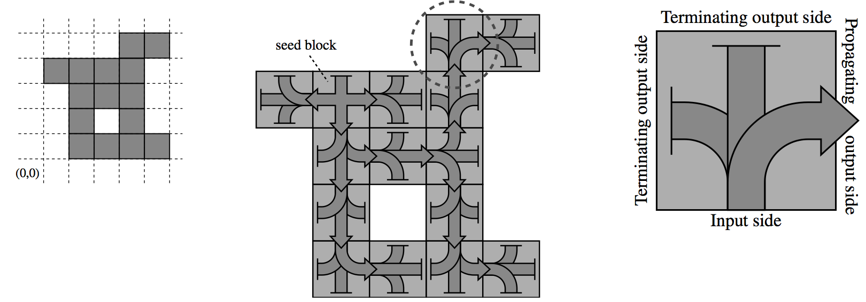
Building any shape optimally
[Soloveichik, Winfree 2007]
Encode shape via Turing machine.
Do a BFS according to current location.
Arbitrary scale factor!

Slide 75
Temperature-2 systems can require
a tile to use cooperative bonds.

Slide 76
Temperature-1 systems do not
have cooperative bonds.

Slide 77
Are τ=1 and τ=2 systems equally powerful?
τ=1 (linear tile types)
τ=2 (logarithmic tile types)
We think building shapes takes linear tile types,
and simulating Turing machines is impossible.
Except in 3D, whereτ=1 can do both of these things…

Slide 78
Abstract Tile Assembly Model (aTAM)

Slide 79
Abstract Tile Assembly Model (aTAM)

Slide 80


Slide 81
A Seedless World?

Slide 82
A Seedless World?

Slide 83
A Seedless World?

Slide 84
A Seedless World?

Slide 85
A Seedless World?
• • •
• • •

Slide 86
Two-Handed Assembly Model (2HAM)

Slide 87
Two-Handed Assembly Model (2HAM)

Slide 88
How powerful is 2HAM relative to aTAM?
Are there techniques that require a seed?
No.

Slide 89
Every aTAM system can be
simulated with a 2HAM system.

Slide 90
Simulation

Slide 91
Simulation

Slide 92
Simulation captures dynamics

Slide 93
Simulation captures production

